Slide 1
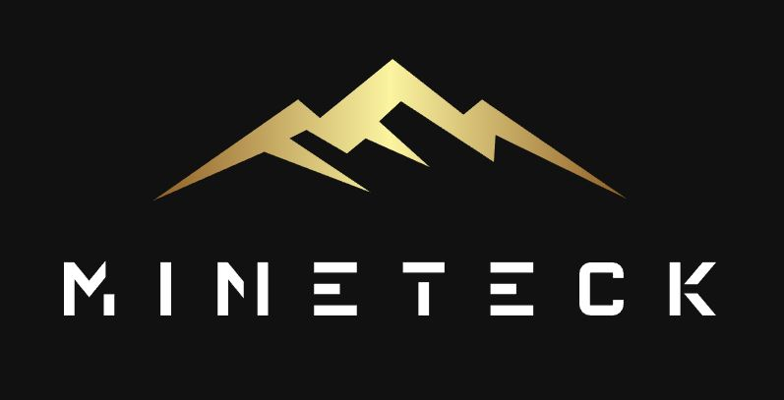
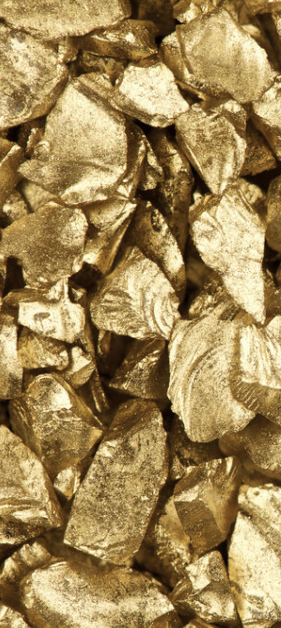
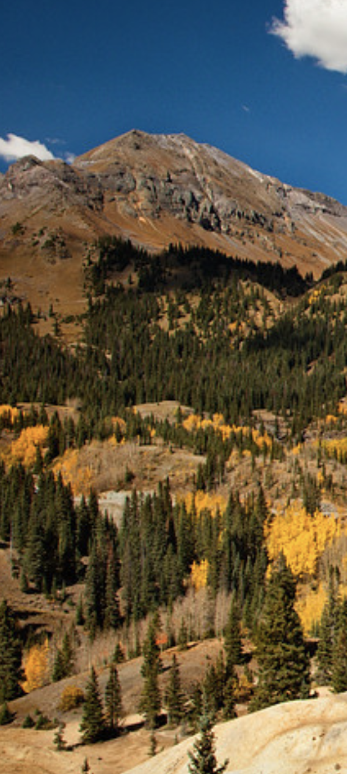
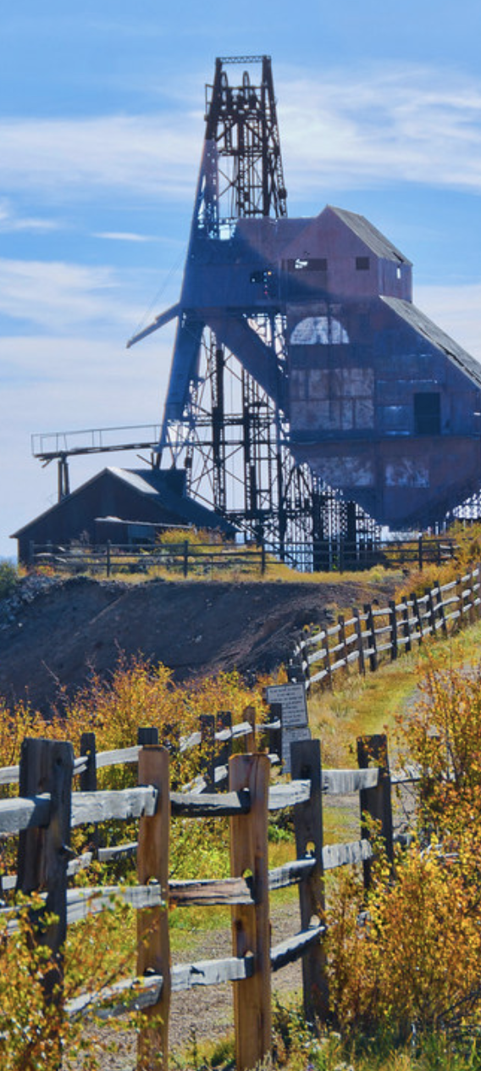
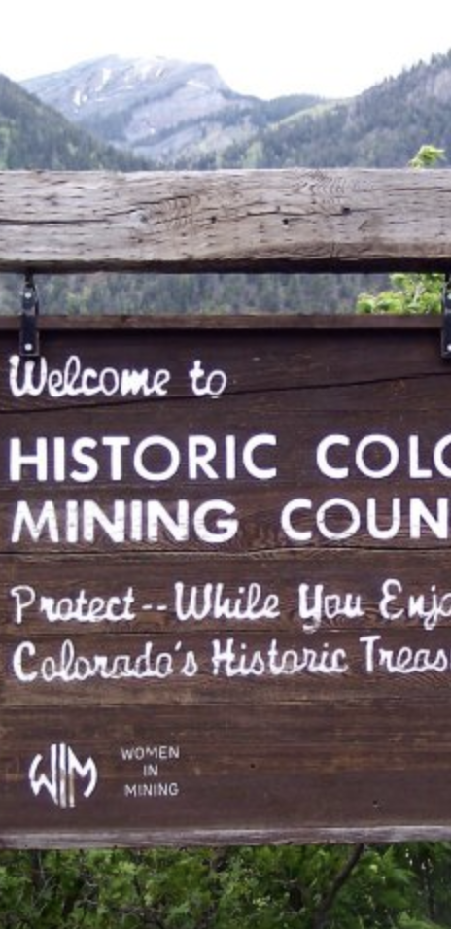
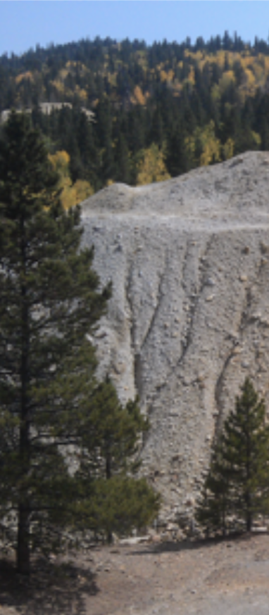
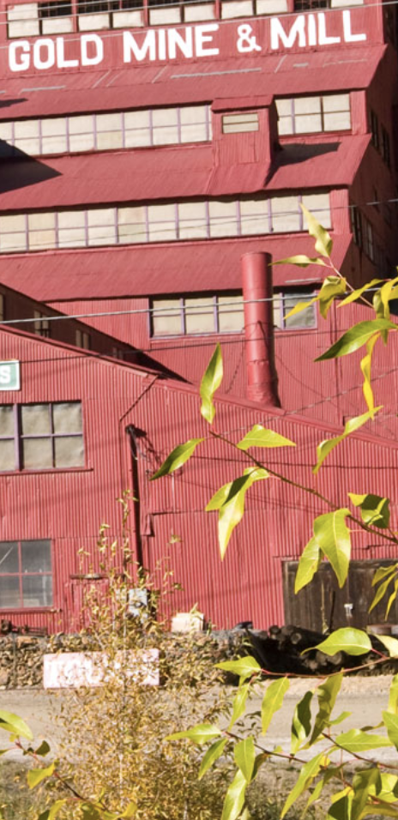
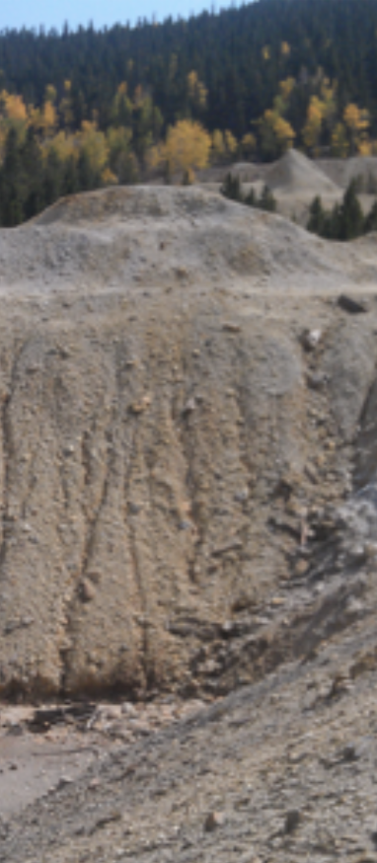
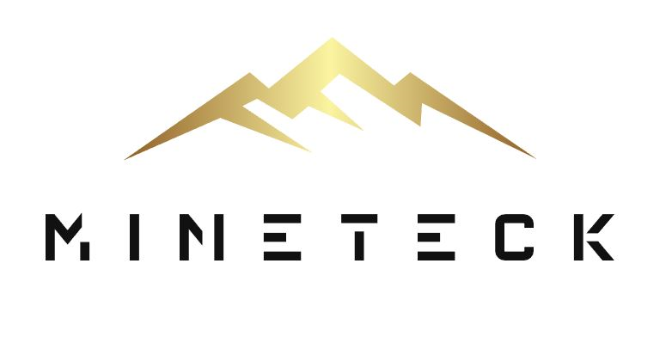
R&D Funding Request
Mobile Research Unit (MRU)
MineTeck LLC

Slide 2
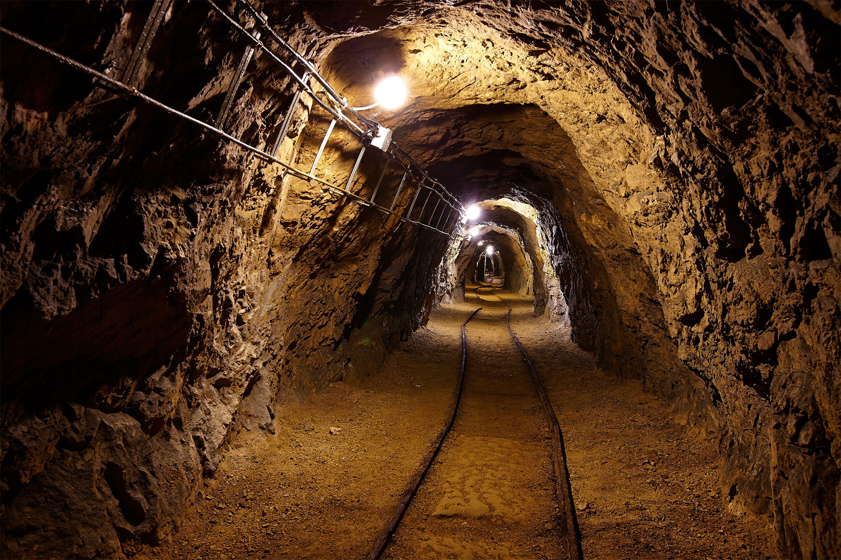
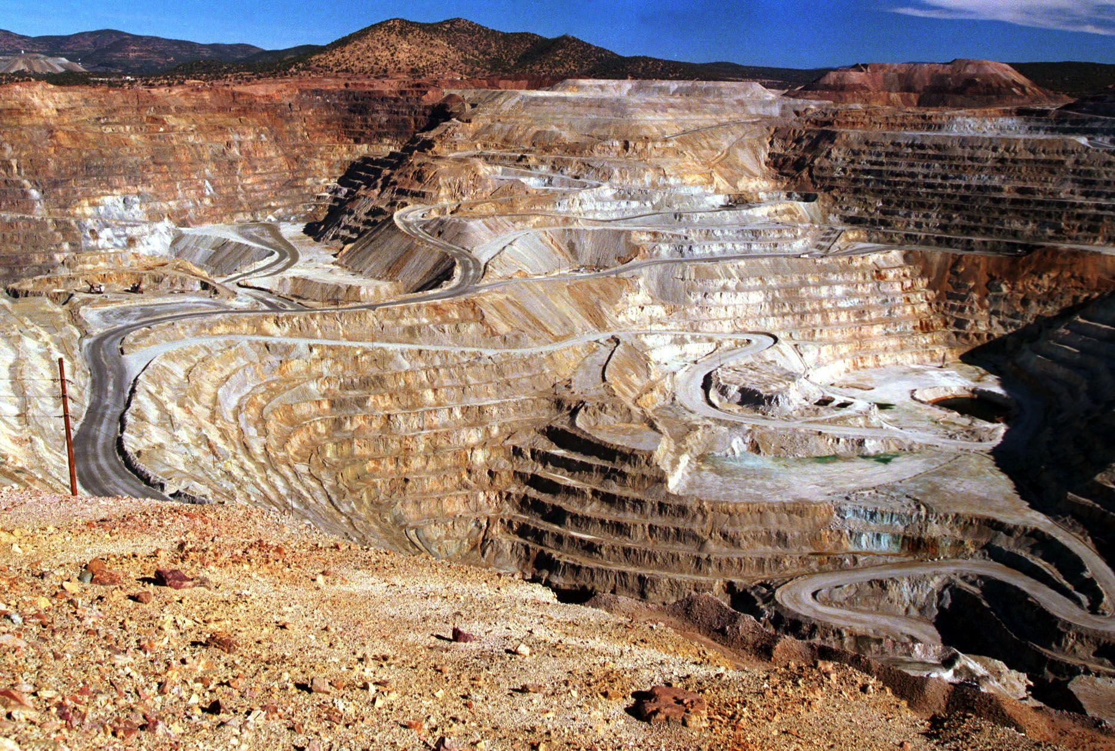
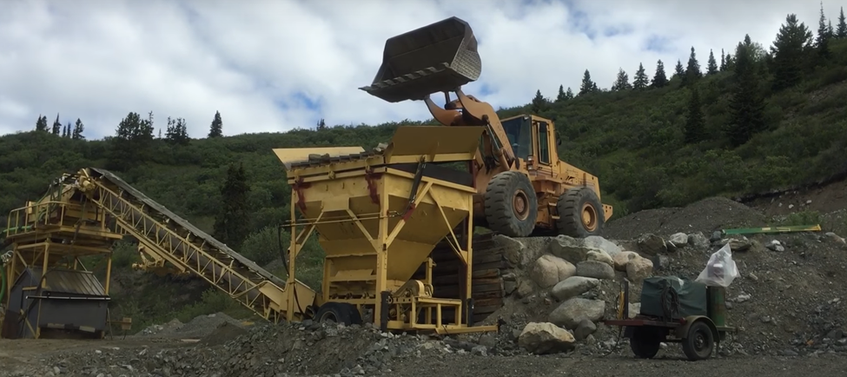
Mining
MineTeck LLC

Slide 3

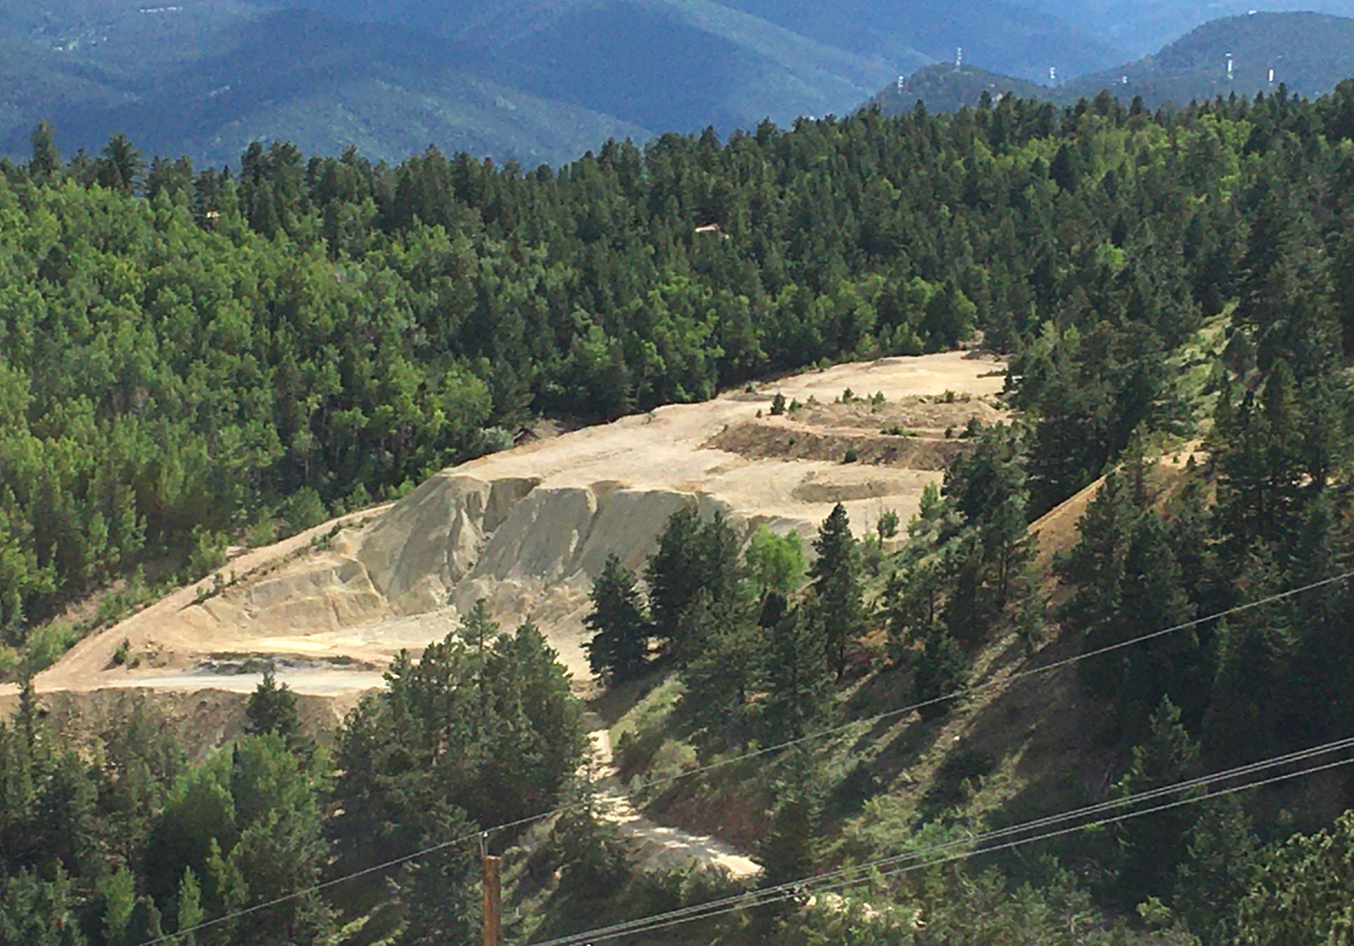

Slide 4
Mining

Slide 5
Mining

Slide 6
Problems in Mining
Waste - tailings

Slide 7
Problems in Mining
Waste
Environment Issues / Permitting

Slide 8
What are tailings?
Mining Processes
Byproducts
Rock
Sand
???
Lead (Heavy Metals)
Sulfuric Acid
Arsenic

Slide 9
Problems in Mining
Waste
Environment Issues / Permitting
Recovery

Slide 10
Problems in Mining
Waste
Environment Issues / Permitting
Recovery
Marketing / Sales

Slide 11
Impact
28,000 Abandoned Mines in Colorado
18,000 Registered Mines not operating
> 100M Tons of Material = $Billions

Slide 12
Need
Zero / low Waste Recovery Process
Zero / low Toxicity Recovery Process
Help with Permitting
Increased Recovery
Market Low-Grade

Slide 13
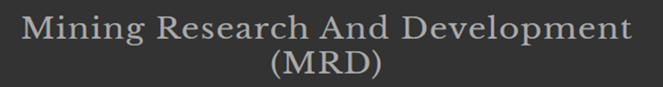
1st Fully Permitted Mill in 20 years
Proprietary Zero Waste / Low Toxicity Technologies
Increased Recovery
Process Patentable
Network of World-Wide Refineries for Low-Grade Materials

Slide 14
Technology
Mobile Processing Plants

Slide 15
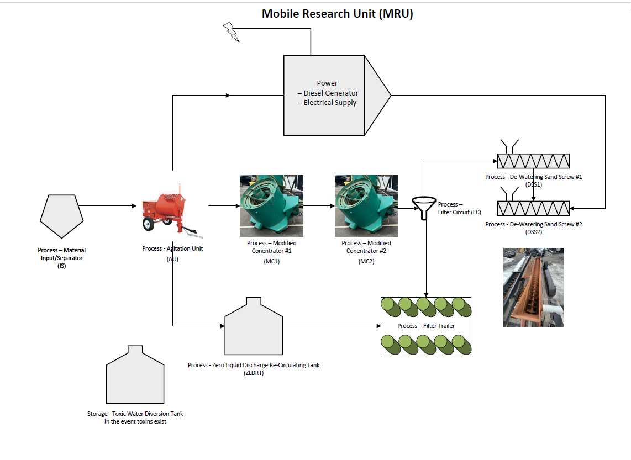
Mobile Research Unit (MRU)

Slide 16
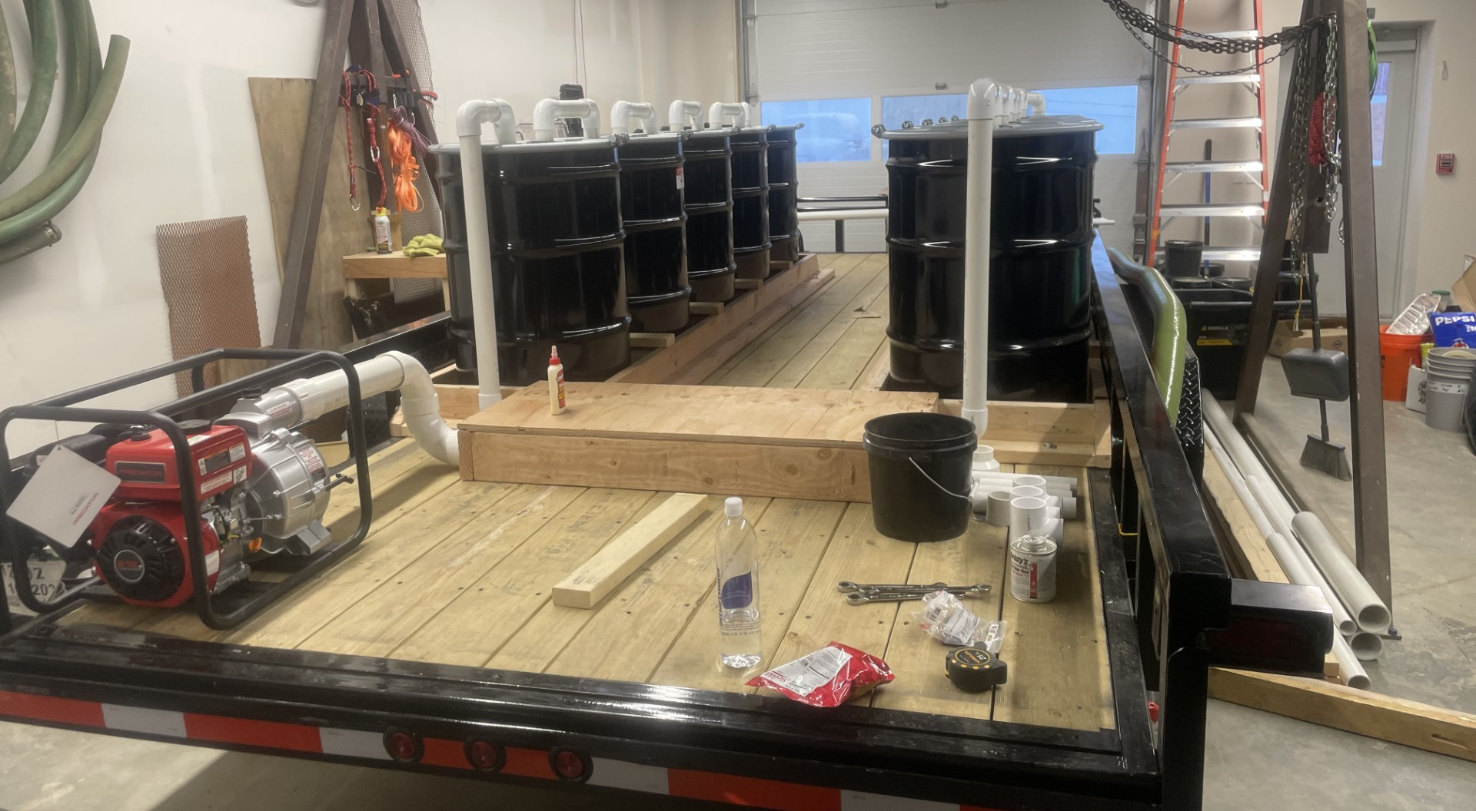
Our New Mobile Unit (MRU)

Slide 17
Mobile Research Unit (MRU)
Mobile
Self-Contained / Water Recirculation
Zero Liquid Discharge
Toxin Capture Technology
Clean / Zero Waste (No Tailings Pile)
30TPH Capacity
Demonstration Permit
Flagship of Future Equipment Sales

Slide 18
Projects
Direct Mining and Reclamation Projects

Slide 19
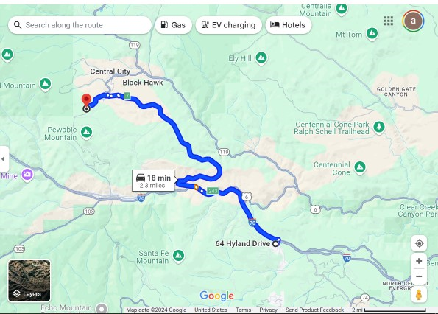
Russell Gulch, Colorado

Slide 20
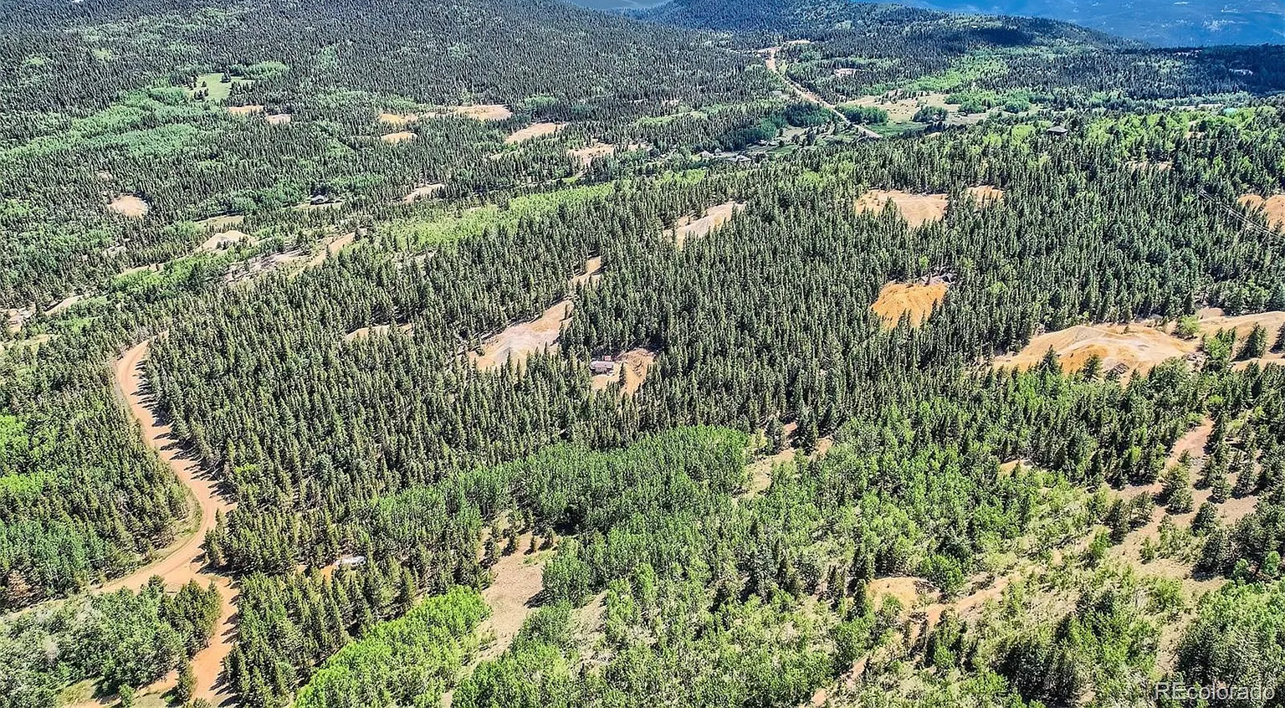
Russell Gulch, Colorado

Slide 21
Russell Gulch, Colorado
Historic Gold Mining in “Richest Square Mile”
Dump Ore from Old Mining Operations
Estimated 100K + Tons of Material on the Ground
Initial Assays Showing an avg of 10gpt
Property purchased under JV w Real Estate Developer
Plan to Recover, Explore, Mine and, Ultimately Develop Real Estate
$24M Project with just Dump Ore @3gpt

Slide 22
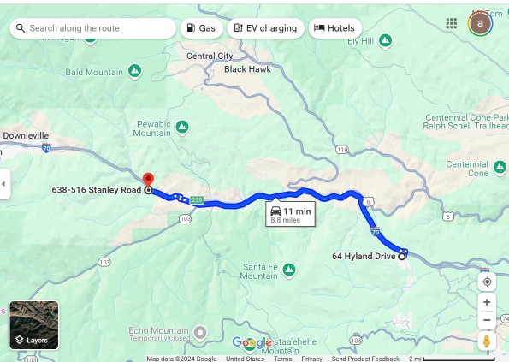
Gladstone Mill, Colorado

Slide 23
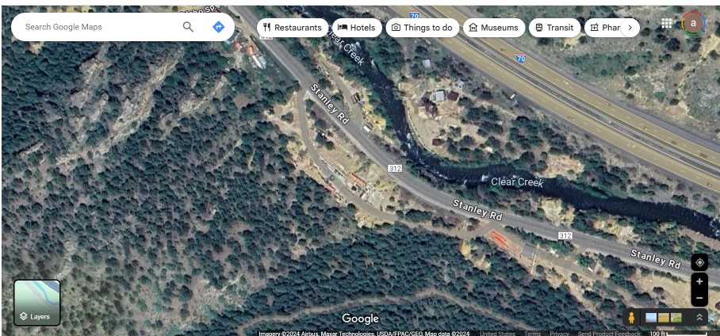
Gladstone Mill, Colorado

Slide 24
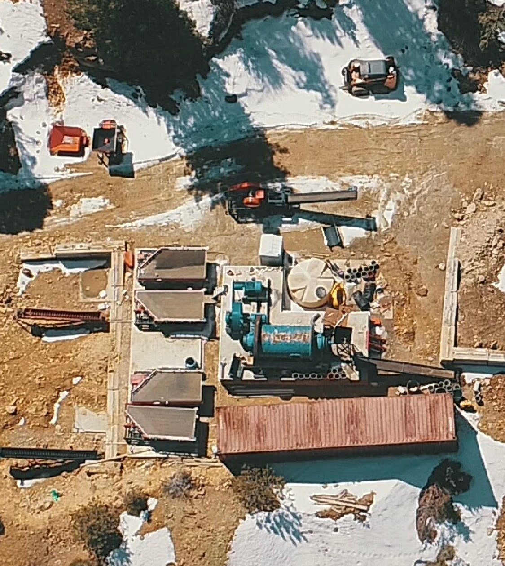
Gladstone Mill, Colorado
1st Permitted Toll Mill in Colorado in 20 years
$400k in land value
$300k in permitting costs
$200k in infrastructure
$17M in revenue as a toll mill
$40M potential in milling our own material from 4 patented mines on the property
Keystone Project for MineTeck for Decades

Slide 25
Gladstone Mill, Colorado
Permitted 70k Ton / Yr Mill
Current Capacity 3 Tons Per Hour
Seeking to acquire property through legal action to dissolve other partnership
Rehab & Operate at Current Capacity
Order Equipment & Set Up New Mill
Increase Production to New Capacity
Create High-Grade Concentrate at Mill then Blend with Low-Grade Concentrates from Various Sites

Slide 26
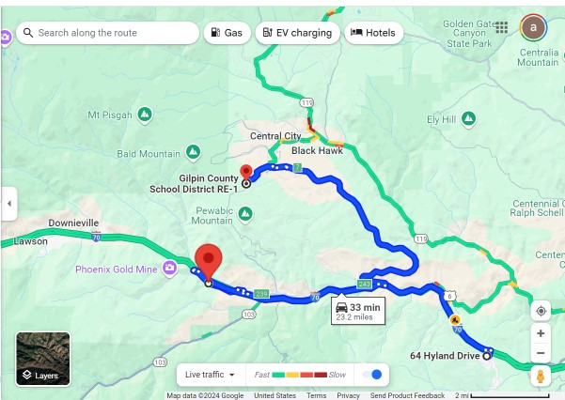
MineTeck, Colorado

Slide 27
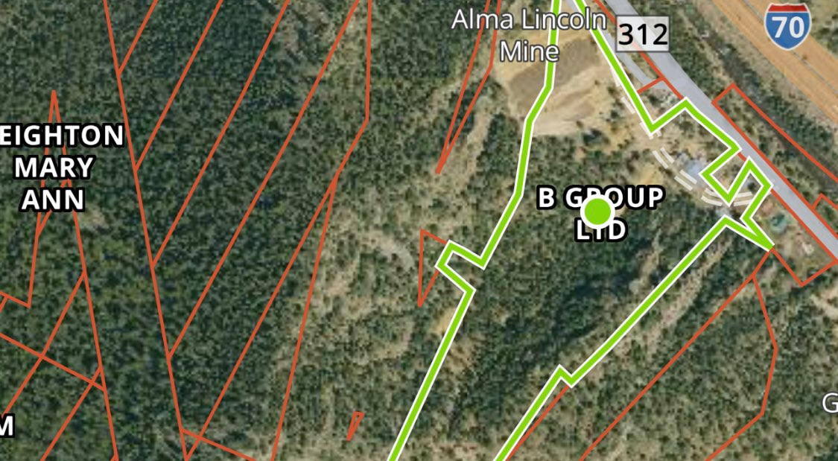
B Group Property, Colorado
Key Property is 5 Acres with large dump pile

Slide 28
B Group Property, Colorado
B Group Property Adjoins Gladstone Mill Property on Clear Creek Establishing a Substantial Home Base for MineTeck

Slide 29
Project “B”, Colorado
Historic Gold Mining in “Richest Square Mile”
Dump Ore from Old Mining Operations
Estimated 500K + Tons of Material on the Ground
Initial Assays Showing an avg of 6gpt
Plan to Purchase, Recover, Explore, Mine
10 year - $85M Project with just Dump Ore @3gpt

Slide 30
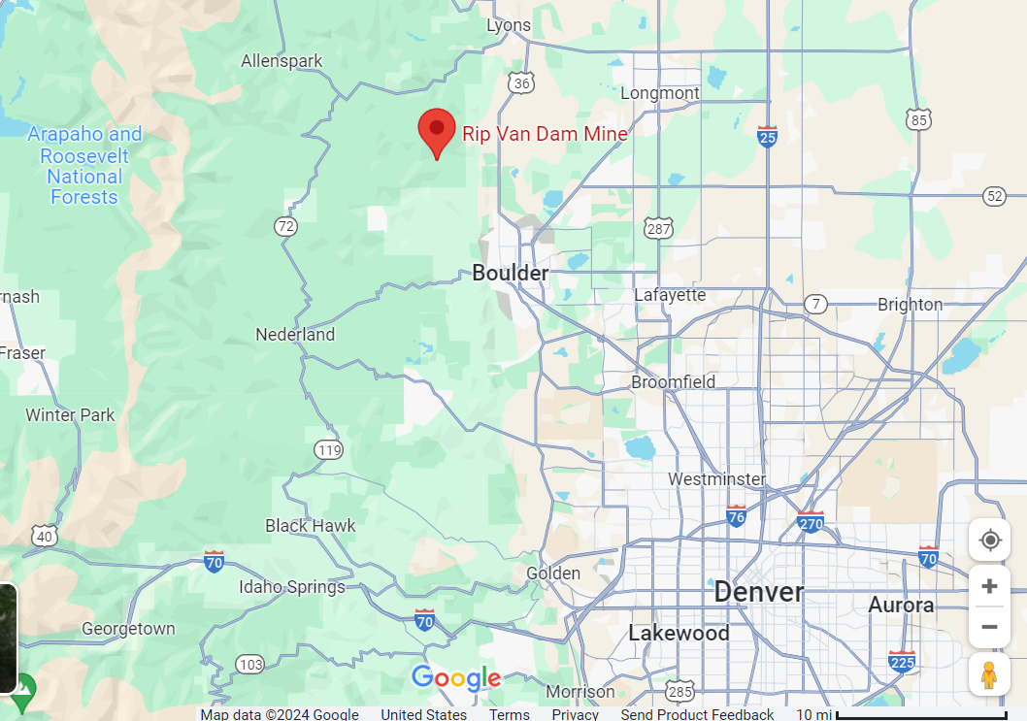
Rip Van Dam Mine, CO

Slide 31
Rip Van Dam Mine
4 Mines together on 15 acres
Near Boulder, CO
Platinum, Palladium, and Rhodium mine also having gold and silver
Initial Exploration and Testing indicates values as high as $7,000 per ton
Property under contract but there is an issue with access due to a difficult neighbor.
We’ll proceed when access is resolved.

Slide 32
Looking Forward
Setting Up Operation at Russell Gulch
Purchase Property “B” and Set Up Operations
Secure Gladstone Mill and Finish Construction and Begin Operations
Secure Rip Van Dam Mine and Begin Exploration
Continue to Evaluate and Pursue New Opportunities
Seeking Funding for Next Steps

Slide 33
MineTeck 5YR Summary Financials – Revised 11/24
 | 2025 | 2026 | 2027 | 2028 | 2029 | Total
Revenue
Russell Gulch | $7,133,226 | $8,661,774 | $8,661,774 |  |  | $24,456,774
Property B |  | $8,661,774 | $8,661,774 | $8,661,774 | $8,661,774 | $34,647,096
Gladstone Mill |  | $12,000,000 | $17,000,000 | $17,000,000 | $17,000,000 | $63,000,000
Total Revenue | $7,133,226 | $29,323,548 | $34,323,548 | $25,661,774 | $25,661,774 | $122,103,870
Operating Expenses | $1,259,786 | $9,236,918 | $10,811,918 | $8,083,459 | $8,083,459 | $37,475,539
Gross Profit | $5,873,440 | $20,086,630 | $23,511,630 | $17,578,315 | $17,578,315 | $84,628,331
Management, Taxes | $587,000 | $1,398,837 | $1,537,776 | $1,198,890 | $1,198,890 | $5,921,393
Net Profit | $5,286,440 | $18,687,793 | $21,973,854 | $16,379,425 | $16,379,425 | $78,706,938
More Projects will be added over the years to add additional revenue.

Slide 34
Use of Funds
Round Two Capital Raise - $1,000,000
Land Purchase and Related Costs - $500,000
General Development Costs - $200,000
Working Capital - $290,000
Cost of Placement – $10,000

